Slide 1
Advancing Engineering Design Guidance for Constructed Salt Marshes with High Fidelity Modeling and Long-Term Monitoring
Project Number: NH24-8072
Principal Investigator: Todd Steissberg
PI’s Organization: Environmental Laboratory, U.S. Army Engineer Research and Development Center
In Progress Review Meeting
June 4, 2025

Slide 2
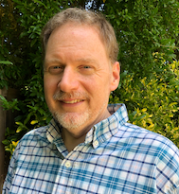
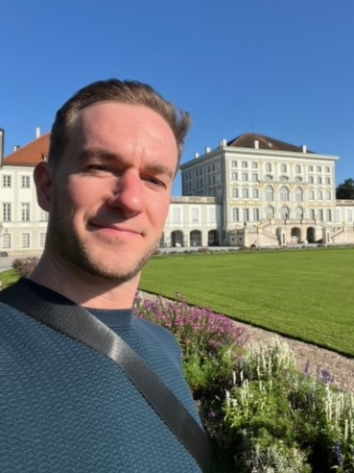

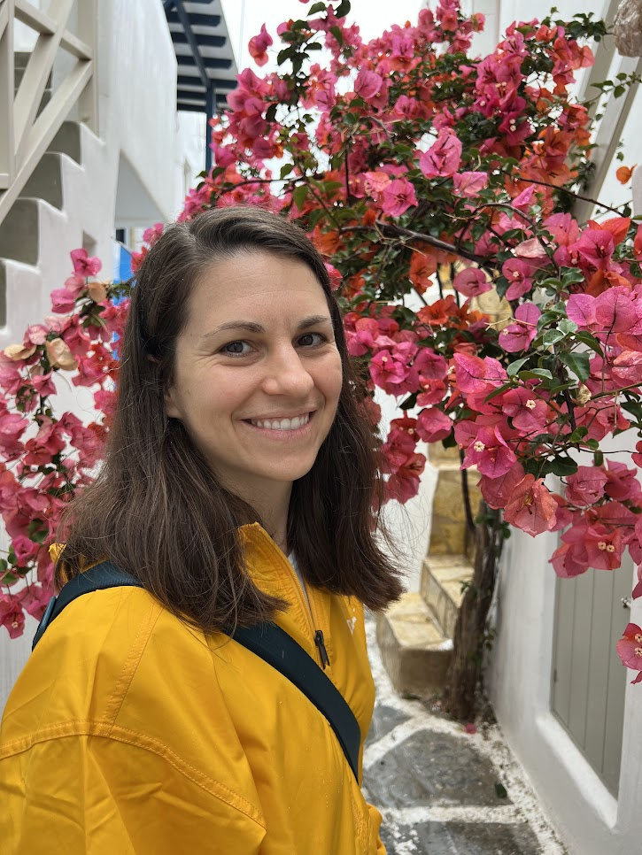
Project Team
Todd Steissberg, Lead PI
Environmental Laboratory US Army Research and Development Center
Co-Performers and Host Military Installation POCs:
Scott Mauro, NAVFAC Engineering & Expeditionary Warfare Center
Mark Patterson, NAVFAC Engineering & Expeditionary Warfare Center
Collaborators:
Deltares
San Francisco Environmental Institute (SFEI)
Matt Smith, Co-PI
Institute for Water US Army Corps of Engineers
Marriah Abellera, Co-PI
Institute for Water US Army Corps of Engineers
Jenny Olszewski, Co-PI
USGS
Notes:
Don’t spend too much time presenting this slide.

Slide 3
Bottom Line Up Front
Provide a response to the following four questions in a high-level or “BLUF” format to set the stage for the important themes that will be discussed throughout the rest of the presentation.
What technology or methodology is being evaluated during this demonstration?
What’s been going well?
What’s not working?
What support do you need?
This quarter marked the successful completion of Phase I of the project, which focused on data collection, model development, and identification of key calibration parameters for the fully integrated hydrodynamic, wave, and vegetation model. The team has since initiated Phase II and are making steady progress toward completing calibration and validation of the model. Our partners have provided immense support regarding data collection, subject matter consultation, and the identification/selection of a second marsh site. Despite internal administrative delays and staff turnover, the team is poised to accelerate model validation and simulation efforts in the next quarter and realign with the overall project timeline.

Slide 4
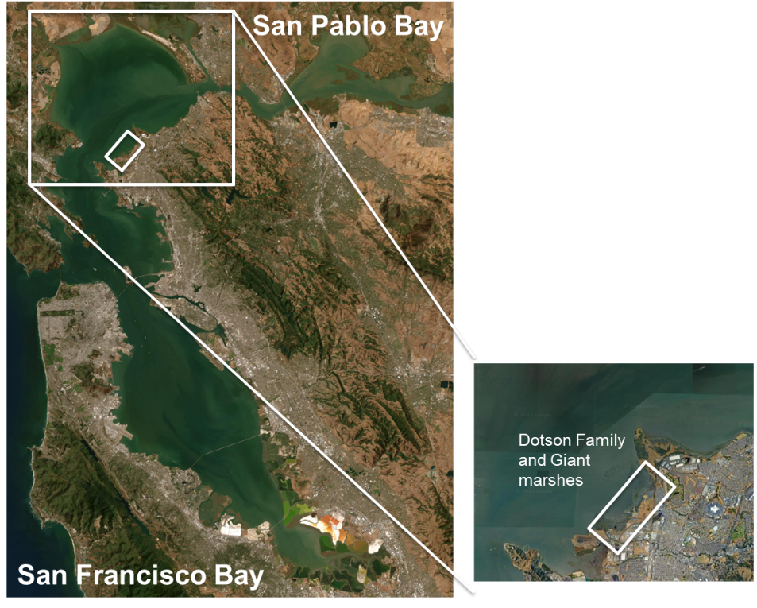
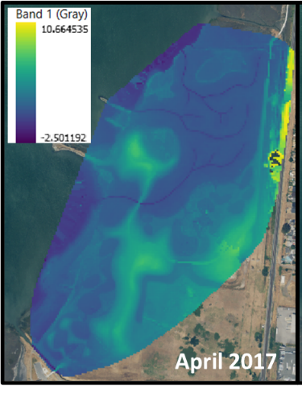
Site Description
Dotson Family Marsh, San Pablo Bay, CA
30-acre tidal marsh habitat with a mix of high and low marsh habitat and mudflats.
The site partially restored in 2015-2016. This restoration focused on removing fill soil and adding tidal channels to re-establish the natural marsh plain.
This marsh sits adjacent to an unrestored (natural) benchmark site – Giant Marsh.
Low wave energy environment that has demonstrated successful vegetation establishment and growth since 2017.

Slide 5
Technical Approach and Test Design
Technical Objectives
Validate and calibrate developed salt marsh model for one selected benchmark (natural) or reference (long-term restoration) and one more recent restoration site.
Evaluate wave attenuation and habitat performance at paired sites under historic conditions.
Evaluate wave attenuation and habitat performance at paired sites under a range of potential future sea level rise scenarios.
Use lessons learned to develop initial recommendations for a framework linking modeling, field and lab research, monitoring, and design evolution.
Notes:
This section should encompass several slides. Liberal use of schematic diagrams, tables, and figures is encouraged.
Provide a description of the system design and testing to be conducted to address the performance objectives. Include issues such as:
Conceptual experimental design
Baseline characterization activities
Design and layout of technology components
Field testing
Sampling plan
Describe how the project will measure the baseline/current approach to the problem compared to the new technology/methodology
Examples: side-by-side, baseline/intervention or sequential testing
Consider: What changes?, What key measurements depict change?
Briefly describe the technical objective(s) of the demonstration project

Slide 6
Technical Approach and Test Design (Technical Approach Example diagram on next slide)
Technology: This effort proposes two contributions to the existing salt marsh modeling field
To develop a spatially distributed model that builds on existing models to strengthen the feedback loops existing between hydrodynamics, morphology, and vegetation lifecycle processes; and
To use that model to develop a framework for salt marsh design for specific performance objectives.
Notes:
This section should encompass several slides. Liberal use of schematic diagrams, tables, and figures is encouraged.
Provide a description of the system design and testing to be conducted to address the performance objectives. Include issues such as:
Conceptual experimental design
Baseline characterization activities
Design and layout of technology components
Field testing
Sampling plan
Describe how the project will measure the baseline/current approach to the problem compared to the new technology/methodology
Examples: side-by-side, baseline/intervention or sequential testing
Consider: What changes?, What key measurements depict change?
Briefly describe the technical objective(s) of the demonstration project

Slide 7
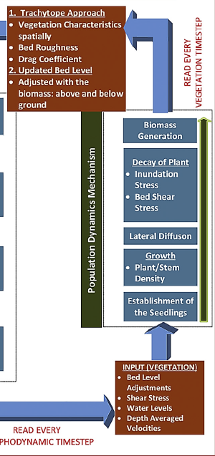
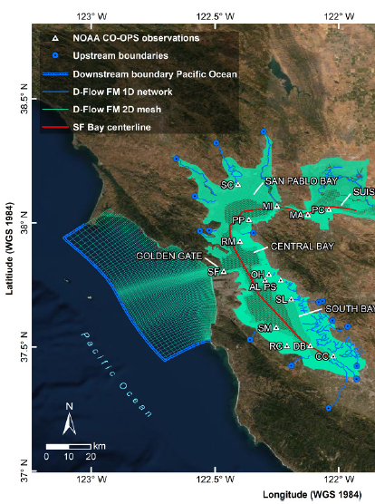
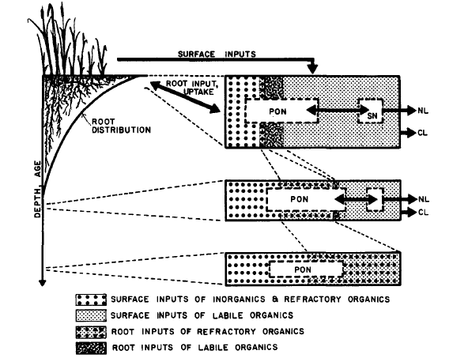
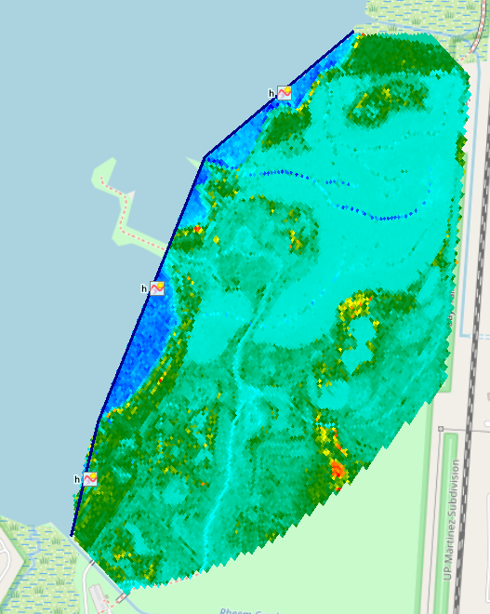
Technical Approach and Test Design (Technical Approach Example diagram on next slide)
We are currently linking the existing NBSDynamics (vegetation) model and coding up the SEMIDEC (sediment) models to the hydrodynamic and wave model developed for Dotson Family Marsh (nested within the larger SF Bay model developed by Nederhoff et al. (2021))
NBSDynamics model diagram developed by Best et al. (2018)
7
Notes:
This section should encompass several slides. Liberal use of schematic diagrams, tables, and figures is encouraged.
Provide a description of the system design and testing to be conducted to address the performance objectives. Include issues such as:
Conceptual experimental design
Baseline characterization activities
Design and layout of technology components
Field testing
Sampling plan
Describe how the project will measure the baseline/current approach to the problem compared to the new technology/methodology
Examples: side-by-side, baseline/intervention or sequential testing
Consider: What changes?, What key measurements depict change?
Briefly describe the technical objective(s) of the demonstration project

Slide 8
Technical Approach and Test Design
Experimental treatments (independent variables to be perturbed):
Historical water levels
Projected high, medium, and low sea level rise scenarios
Starting mean bottom elevation (existing, low, and high scenarios)
Sediment loadings (existing, low, and high scenarios) (if computing power and time allow)
Model simulations
Historical period runs (for restored and benchmark/reference sites):
2 x (1 water level scenario) x (3 bottom elevation scenarios) x (3 sediment loading scenarios) = 6 to 18 scenarios
Future scenario runs (for restored and benchmark/reference sites):
2 x (3 water level scenario) x (3 bottom elevation scenarios) x (3 sediment loading scenarios) = 18 to 54 scenarios
Experimental Controls: The benchmark/reference marsh site performance under historical conditions will serve as the baseline for this experiment. We will assume that long-established and/or natural marshes have reached an equilibrium state with respect to sediment accretion and vegetation coverage under current conditions. Therefore, the benchmark/reference site should exhibit optimal performance for that region and marsh type.
Notes:
This section should encompass several slides. Liberal use of schematic diagrams, tables, and figures is encouraged.
Provide a description of the system design and testing to be conducted to address the performance objectives. Include issues such as:
Conceptual experimental design
Baseline characterization activities
Design and layout of technology components
Field testing
Sampling plan
Describe how the project will measure the baseline/current approach to the problem compared to the new technology/methodology
Examples: side-by-side, baseline/intervention or sequential testing
Consider: What changes?, What key measurements depict change?
Briefly describe the technical objective(s) of the demonstration project

Slide 9
Technical Approach
SITE SELECTION /
DATA COLLECTION
Task 1: Consult SFEI experts to determine key calibration parameters.
Task 2: Select benchmark / reference and restoration marsh sites
Task 3: Evaluate if additional data collection needed
Task 4: Collect data if necessary
Go/no go
Task 5: Calibrate and validate model
Go/no go
MODEL SIMULATION
Task 6: Simulation (historic conditions)
Task 7: Simulation (future sea level rise scenarios)
Go/no go
Task 8: Analyze outputs
REPORTING /
TECH TRANSFER
Task 9: Design framework recommendations
Task 10: Final ESTCP Report
Task 11: Technology Transfer
9

Slide 10
Performance Objectives
Performance Objective | Metric | Data Requirements | Data Requirements |  | Success Criteria
Quantitative Performance Objectives
Model calibration and validation | Goodness-of-fit of the model for salt marsh sites selected | Vegetation cover data Hourly water level data Hourly water velocity data Sediment loadings / concentrations Salt marsh elevation data Vegetation mortality rates Vegetation establishment rates Biomass accretion rates | Vegetation cover data Hourly water level data Hourly water velocity data Sediment loadings / concentrations Salt marsh elevation data Vegetation mortality rates Vegetation establishment rates Biomass accretion rates |  | Root mean square error < 0.5
Create salt marsh habitat | Area of high marsh habitat low marsh habitat mudflat habitat | Vegetation cover data Daily water level data Daily water velocity data Salt marsh elevation measurements | Vegetation cover data Daily water level data Daily water velocity data Salt marsh elevation measurements |  | (current habitat area achieved) / (habitat area goal) > 0.7 (projected future habitat area achieved) / (habitat area goal) > 0.5
Wave Attenuation | Daily mean wave height attenuation | Hourly water level data at bay and shore side of marsh Hourly wave data at bay and shore side of marsh | Hourly water level data at bay and shore side of marsh Hourly wave data at bay and shore side of marsh |  | (mean historical wave height at shore side) /(mean historical wave height on bayside) < 0.8 (mean projected wave height at shore side) / (mean projected wave height on bayside) < 0.6
Relationships between marsh characteristic and performance metrics | Correlation coefficient | Dependent on trends identified through simulation | Dependent on trends identified through simulation |  | Correlation coefficient > 0.5
Qualitative Performance Objectives
Technology transfer effectiveness | Successful communication of lessons learned and implications for marsh design |  | Feedback from audiences | Interest in pursuing future efforts to update formal salt marsh framework recommendations for DoD.
Notes:
Provide the performance objectives table from the demonstration plan.
Provide additional slides as needed to describe the methods for collecting and analyzing the data required to assess the quantitative performance objectives

Slide 11
Results to Date
Phase I: Site Selection and Identification of Key Calibration Parameters
The team identified key calibration parameters for the first restoration site, Dotson Family Marsh, and our benchmark (natural) site, Giant Marsh. We selected a range of calibration parameters (outlined in the Subtask 1.3 report) and include input time series data:
Water levels surrounding the marsh (sub-hourly)
Wind/waves entering the marsh (sub-hourly)
And input boundary conditions:
Initial marsh water levels
Initial morphology
Initial vegetation coverage
Initial marsh sediment concentration
Mean sediment concentrations surrounding the marsh
Figure. Visual representation of simulated water levels in Dotson Family Marsh in 2016 following restoration.
Notes:
This section should encompass several slides. The use of graphics/pictures/graphs/tables is strongly encouraged. Ensure font size on graphics/tables/graphs is large enough to be easily read by the audience and includes captions, table headings, axis labels, or legends as applicable.

Slide 12
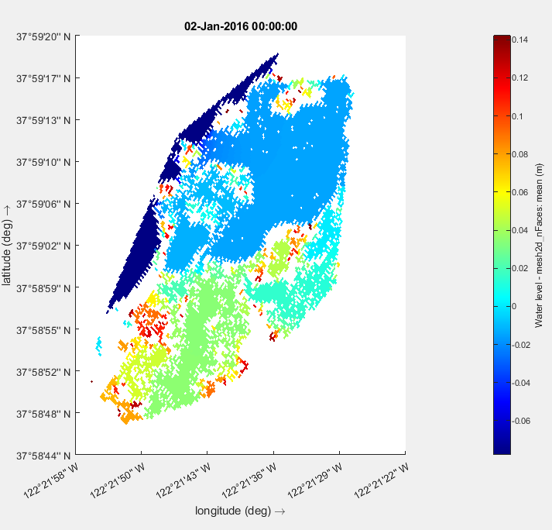
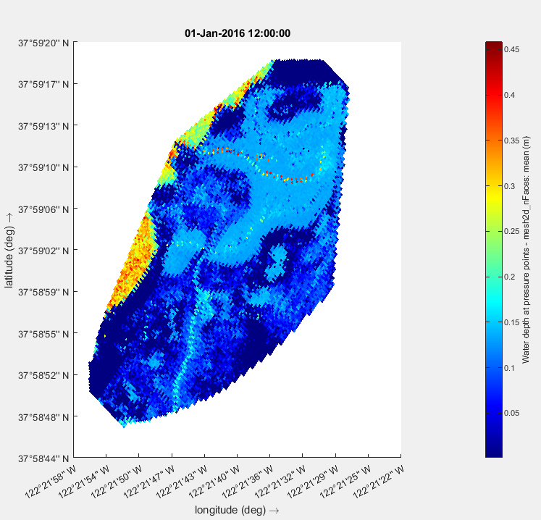
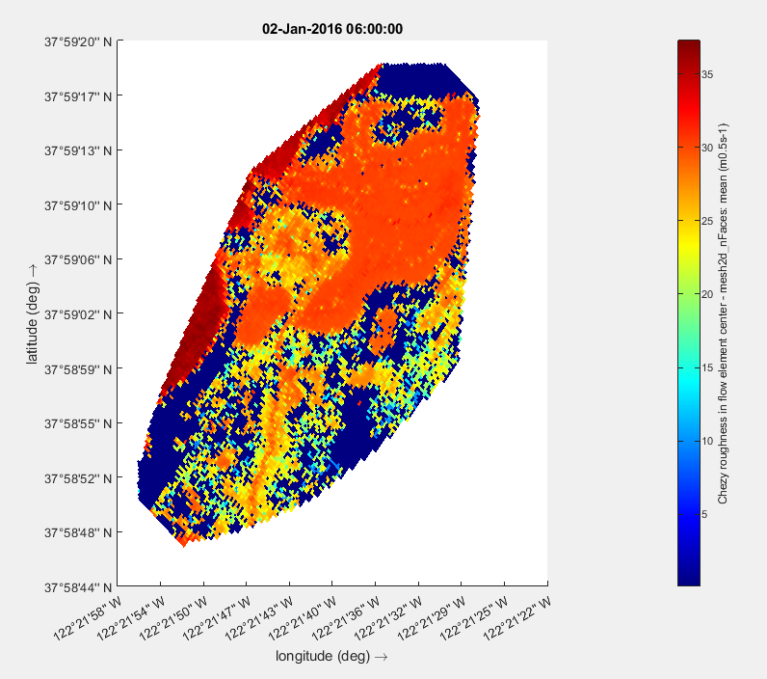
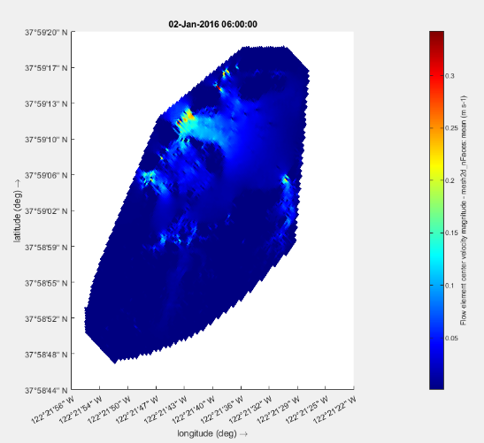
Results to Date
Phase II: Model Calibration and Validation
The team performed initial calibration of the hydrodynamic and wave modules in Delft3D (separately and coupled) to test the accuracy and robustness of the model. We followed calibration methods similar to those defined in Nederhoff et al. (2021).
We used OpenDA, an open interface tool for rapid calibration and data assimilation, to calibrate the Delft3D hydrodynamic and wave models.
We ran several preliminary calibration simulations – interchanging parameter combinations and estimates for each simulation. The goal of this effort was to minimize the difference between observed values and model outputs (RMSE <0.5).
Figure. A subset of preliminary model testing using specified calibration parameters in Delft3D depicting a) cell averaged water level, b) cell averaged water depth, c) Chezy roughness, and d) flow velocity.
Notes:
This section should encompass several slides. The use of graphics/pictures/graphs/tables is strongly encouraged. Ensure font size on graphics/tables/graphs is large enough to be easily read by the audience and includes captions, table headings, axis labels, or legends as applicable.

Slide 13
Results to Date
The team has made significant progress toward full calibration of the hydrodynamic and wave models and will soon be able to calibrate the integrated vegetation components with support from Deltares.
We will compare calibration ‘goodness-of-fit’ across all models (separately and fully integrated). Specifically, we will evaluate 1) overall RMSE and bias, and 2) residual areas with large discrepancies in model output. Our goal is to understand how the fully integrated model will reproduce vegetation extent and sediment accretion for the observed time periods.
With support from local partners, SFEI and EBRPD, the team will compare model output with storm event information and determine the ability for the model detect the presence of hydrologic or morphologic anomalies.
The team is working with Navy subject matter experts to gather data at the second site and determine next steps for calibration using a similar model setup. More information will be shared in the next quarterly progress report.
Notes:
This section should encompass several slides. The use of graphics/pictures/graphs/tables is strongly encouraged. Ensure font size on graphics/tables/graphs is large enough to be easily read by the audience and includes captions, table headings, axis labels, or legends as applicable.

Slide 14
Issues
Describe any unanticipated or unresolved issues that are impacting or may impact success of the demonstration. Describe any other changes/opportunities faced by the project.
If an issue is of such significance that the PI believes additional discussions with the Program Office is required, then the following items must be described:
Nature of the issue
Financial implications and reasoning
Impacts to project time frame
Due to staff turnover and internal administrative delays, we have not yet been able to calibrate the vegetation components of our coupled model. This includes the accretion and NBSDynamics modules. We are currently working with Deltares to fully integrate both components into Delft3D Flow-Wave modeling suite. Once the integration is complete, we will begin calibration to ensure initial model accuracy and robustness using the methods described above.
Notes:
Include slide only if required.

Slide 15
Next Steps
 |  | 2024 |  | 2025 |  |  |  | 2026
Phase | Task | Q3 | Q4 | Q1 | Q2 | Q3 | Q4 | Q1 | Q2 | Q3 | Q4
Site Selection and Key Calibration Parameters | 1
 | 2
 | 3
Calibration and Validation | 4
Model Simulation | 5
 | 6
Output Compilation and Analysis | 7
 | 8
Reporting and Technology Transfer | 9
 | 10
 | 11
 | 12
Annual ESTCP IPR | -- |  |  |  | X |  |  |  | X
Symposium Poster Presentation* | -- |  |  |  |  |  | X |  |  |  | X
Quarterly Reports | --
Submit peer-reviewed journal article | -- |  |  |  |  |  |  |  | X
Final Report | -- |  |  |  |  |  |  | X | X
*The team will present a poster during each active year at the SERDP and ESTCP symposium
Major milestones:
General framework recommendations report (12/31/2025)
Submit peer-reviewed journal article (03/31/2026)
Final Report (03/31/2026)

Slide 16
Impact to DoD Mission
The Program Office wants to convey the significance of your research to DoD leadership, Congress, and the broader community.
What are the 3 max. most impactful/significant things that have happened during this project so far?
Why is this work important to DoD and how is your project advancing DoD capabilities?
How are the project results impacting the broader community?
Notes:
The SERDP ESTCP communications team will review this section for any significant updates that can be shared to demonstrate program successes.

Slide 17
Technology Transfer
Main product: salt marsh model initial engineering design framework
DoD Users: DoD installation and USACE planners, regulators, and coastal engineers
Initial Target Group: DoD planners / coastal engineers on US east coast
Tech Transfer Plan:
Identify and meet w/ key users early on
Work with key users to develop appropriate communication plans for each of their communities
Notes:
NOTE FOR PROJECT TEAM: Technology Transfer Examples
Training workshops, live or via webinar
Presentations at key conferences
Web-based tools (see example at link)
http://t2.serdp-estcp.org/t2template.html#tool=CSIA&page=Introduction
Guidance documents
Technology fact sheets
“How to” Videos
Community open houses

Slide 18
Project Funding (Submit this table to your Program Office 2 weeks in advance of the IPR)
 | FY23 | FY24 | FY25 | FY26 | Total
Proposal Requested ($K) | 348 | 336 | 306 | 0 | 990
Funds Received | 348 | 100 | 0 | 0 | 448
Funds Expended (Invoiced) | 348 | 75 | 0 | 0 | 423
Requested Revised Funding | 348 | 336 | 206 | 100 | 990
Notes:
NOTE FOR PROJECT TEAMS: Example Data filled in – remove and replace with your actual data.
Adjust fiscal years to reflect all years in which funding was received and is planned.
If substantial funds have not been spent from previous years, please provide a revised funding profile for the current fiscal year and future years. Requested funds for the current and future years should be an amount that you expect can be spent within that calendar year (see example next page). Please contact the Program Office in advance of the IPR if you are unclear on how to restructure the funding profile.

Slide 19
BACKUP MATERIAL
These charts are required, but will only be briefed if questions arise.

Slide 20
XXXX-XXXX: Project Title
Performers:
Technology Focus
Summarize technology or methodology being studied or developed
Demonstration Site
Identify the demonstration site location including state
Demonstration Objectives
Summarize performance objectives and criteria for success
Project Progress and Results
Describe significant progress, results, and/or concerns to date
Implementation Status
Identify current or planned end-user coordination, any tech transfer products, next steps, implementation issues.
NOTE: This slide may used by the Program Office in future presentations to provide a brief overview of the project.
Representative graphics

Slide 21
Plain Language Summary
What problem are you addressing?
What are you trying to achieve and how are you doing it?
What are the expected outcomes and how is it advancing existing knowledge?
Note: Focus on points that would be helpful for end users.
Notes:
REFERENCE FOR PROJECT TEAMS: Provide a summary of the problem, the proposed solution and how it addresses or solves the problem. The purpose of this slide is to provide the technical committee (TC) an updated “pitch” on why this project was funded. Some questions to answer:
What technology or methodology is being evaluated during this demonstration?
What is the baseline at most DoD installations for the demonstrated technology? (nationally?)
What is the “state of the art” today?
How will the project advance the state of the art?

Slide 22
Action Items
Using the SERDP and ESTCP Management System (SEMS) as the source, list all ESTCP Review Committee/ Program Office action items (verbatim) assigned over the past year, and any open action items from earlier years. Provide a response as appropriate.
NOTE: Include only if required.
Notes:
Please include in main presentation, prior to backup, if an action item is applicable to this meeting.

Slide 23
Status of Funds for Federal Performers
Report on the status of funds for each MIPR received by a directly funded Federal performer. Provide information on each fiscal year for which there has not been 100% expenditure of funds. If you or your co-performer do not understand how to fill this out, contact your Program Manager in advance of the IPR.
FY20XX Funds
Directly Funded Federal Performer(s) | Funds Received | Funds Obligated* | Percent Funding Obligated
Federal Performer A - Direct Cite MIPR
Federal Performer A - Reimbursable MIPR
Federal Performer B - Direct Cite MIPR
Federal Performer B - Reimbursable MIPR
* Funds put on contracts and/or purchase orders that have been issued, and funds associated with internal labor or travel expenses that have been incurred.
Notes:
NOTE FOR PROJECT TEAM: Report on the status of funds for each MIPR received by a directly funded Federal performer. Provide information on each fiscal year for which there has not been 100% expenditure of funds. If you or your co-performer do not understand how to fill this out, contact your Program Manger in advance of the IPR.

Slide 24
Publications
Provide a list of all publications, patents, awards, etc., resulting from this work.

Slide 25
Literature Cited
Brand, M. W., Buffington, K., Rogers, J. B., Thorne, K., Stein, E. D., & Sanders, B. F. (2022). Multi‐decadal simulation of marsh topography under sea level rise and episodic sediment loads. Journal of Geophysical Research: Earth Surface, 127(9), e2021JF006526.
Buffington, K. J., Dugger, B. D., Thorne, K. M., & Takekawa, J. Y. (2016). Statistical correction of lidar-derived digital elevation models with multispectral airborne imagery in tidal marshes. Remote Sensing of Environment, 186, 616-625.
Foster-Martinez, M. R., Lacy, J. R., Ferner, M. C., & Variano, E. A. (2018). Wave attenuation across a tidal marsh in San Francisco Bay. Coastal Engineering, 136, 26-40.
Nederhoff, K., Saleh, R., Tehranirad, B., Herdman, L., Erikson, L., Barnard, P. L., & Van der Wegen, M. (2021). Drivers of extreme water levels in a large, urban, high-energy coastal estuary–A case study of the San Francisco Bay. Coastal Engineering, 170, 103984
Thorne, K. M., Elliott-Fisk, D. L., Wylie, G. D., Perry, W. M., & Takekawa, J. Y. (2014). Importance of biogeomorphic and spatial properties in assessing a tidal salt marsh vulnerability to sea-level rise. Estuaries and Coasts, 37, 941-951.
Willemsen, P. W. J. M., Smits, B. P., Borsje, B. W., Herman, P. M. J., Dijkstra, J. T., Bouma, T. J., & Hulscher, S. J. M. H. (2022). Modeling decadal salt marsh development: variability of the salt marsh edge under influence of waves and sediment availability. Water Resources Research, 58(1), e2020WR028962.

Slide 26
Technical Risks
ASSUMPTIONS
Appropriate sites and data are available
Significant relationships exist between marsh characteristics and performance objectives
Relationships identified in San Francisco Bay will be transferable to other parts of the US.
RISK MANAGEMENT PLAN
Careful site and data review / selection
Careful scenario selection
SCALE-UP STRATEGY
In order to scale this technology to all relevant coastal DoD installations, additional pilots would be required in future years across the main coastal US regions.

Slide 27
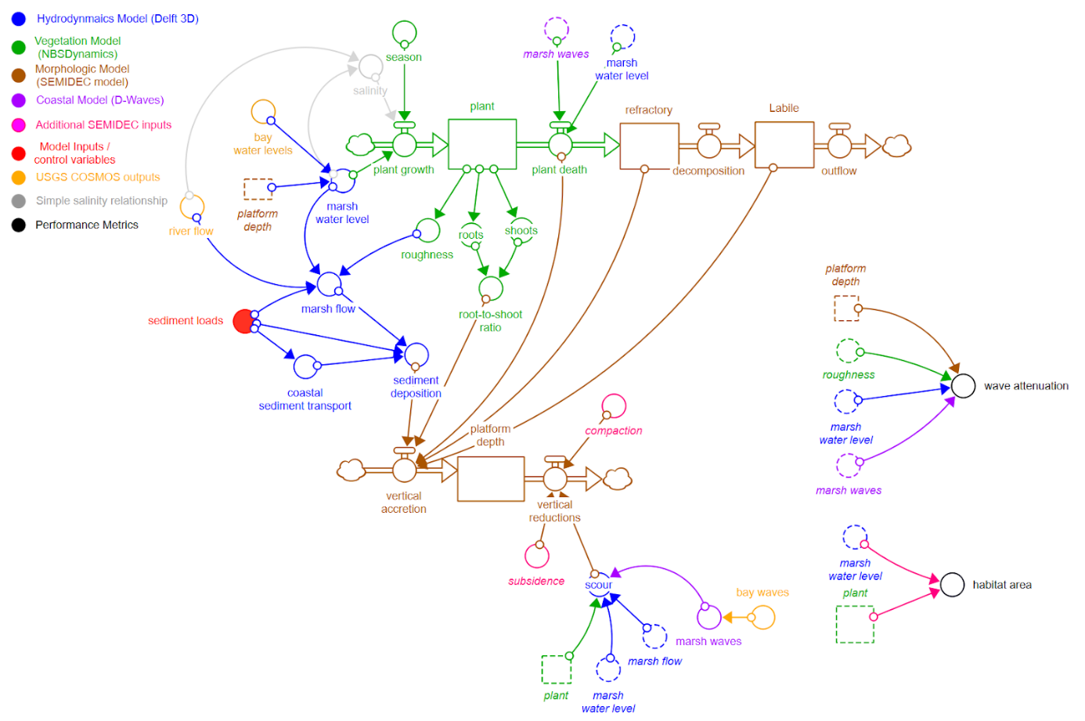
Additional Slide(s) for High-Quality Photos

Slide 28
Acronym List
Delft3D-FM: Delft 3-Dimensional Flexible Mesh
NBSDynamics: Nature Based Solutions Dynamics
RMSE: Root Mean Square Error
SEMIDEC: SEdimentation, MIneralization, and DEComposition model

